Slide 1
The 2023 Financial Crisis Part II
Tom Mack, MBA, A+, Net+
Presenter

Slide 2
Fair Use Notice
The images and videos used in this presentation belong to their respective copyright holders.
These images and videos used in this presentation are used for education, criticism, comment, teaching, and research constituting a Fair Use Exemption under §107 of the United States Copyright Act of 1976.
“Fair Use” is defined as a use permitted by copyright statute that might otherwise be considered infringement.

Slide 3
Disclaimer
The information contained in this presentation is educational material only and is NOT intended to be considered investment advice. Mr. Mack is NOT a registered investment, legal, or tax advisor, or a broker/dealer of securities. All investment/financial opinions expressed by Mr. Mack are from personal research and experience and is intended as educational material only. Although best efforts are made to ensure that all the information contained herein is accurate and up to date, occasionally unintended errors and misprints may occur.

Slide 4
18 U.S. Code §241 - Conspiracy Against Rights
If two or more persons conspire to injure, oppress, threaten, or intimidate any person in any State, Territory, Commonwealth, Possession, or District in the free exercise or enjoyment of any right or privilege secured to him by the Constitution or laws of the United States, or because of his having so exercised the same; or
If two or more persons go in disguise on the highway, or on the premises of another, with intent to prevent or hinder his free exercise or enjoyment of any right or privilege so secured—
They shall be fined under this title or imprisoned not more than ten years, or both; and if death results from the acts committed in violation of this section or if such acts include kidnapping or an attempt to kidnap, aggravated sexual abuse or an attempt to commit aggravated sexual abuse, or an attempt to kill, they shall be fined under this title or imprisoned for any term of years or for life, or both, or may be sentenced to death.
(June 25, 1948, Ch. 645, 62 Stat. 696; Pub. L. 90–284, title I, § 103(a), Apr. 11, 1968, 82 Stat. 75; Pub. L. 100–690, title VII, § 7018(a), (b)(1), Nov. 18, 1988, 102 Stat. 4396; Pub. L. 103–322, title VI, § 60006(a), title XXXII, §§ 320103(a), 320201(a), title XXXIII, § 330016(1)(L), Sept. 13, 1994, 108 Stat. 1970, 2109, 2113, 2147; Pub. L. 104–294, title VI, §§ 604(b)(14)(A), 607(a), Oct. 11, 1996, 110 Stat. 3507, 3511.)

Slide 5
Creation of the Seven Royal Families
And the ten horns out of this kingdom are ten kings that shall arise: and another shall rise after them; and he shall be diverse from the first, and he shall subdue three kings. (Daniel 7:24)
So, he carried me away in the spirit into the wilderness: and I saw a woman sit upon a scarlet-colored beast, full of names of blasphemy, having seven heads and ten horns. (Revelation 17:3)
And the ten horns which thou sawest are ten kings, which have received no kingdom as yet; but receive power as kings one hour with the beast. These have one mind, and shall give their power and strength unto the beast. (Revelation 17:12-13)

Slide 6
Creation of the Seven Royal Families
When Daniel wrote this, none of these royal families existed. They didn’t exist when John Mark wrote Revelation.
The other king that shall arise after them could be the House of Romanov (Russia). They have lots of scores to settle and China is willing to align with them. China has plenty of scores to settle with the Royal Families as well.
The power of the Beast System comes only when the Seven Royal Families can unify into one family.

Slide 7
Creation of the Seven Royal Families

Slide 8
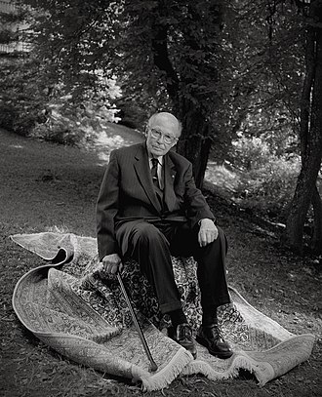
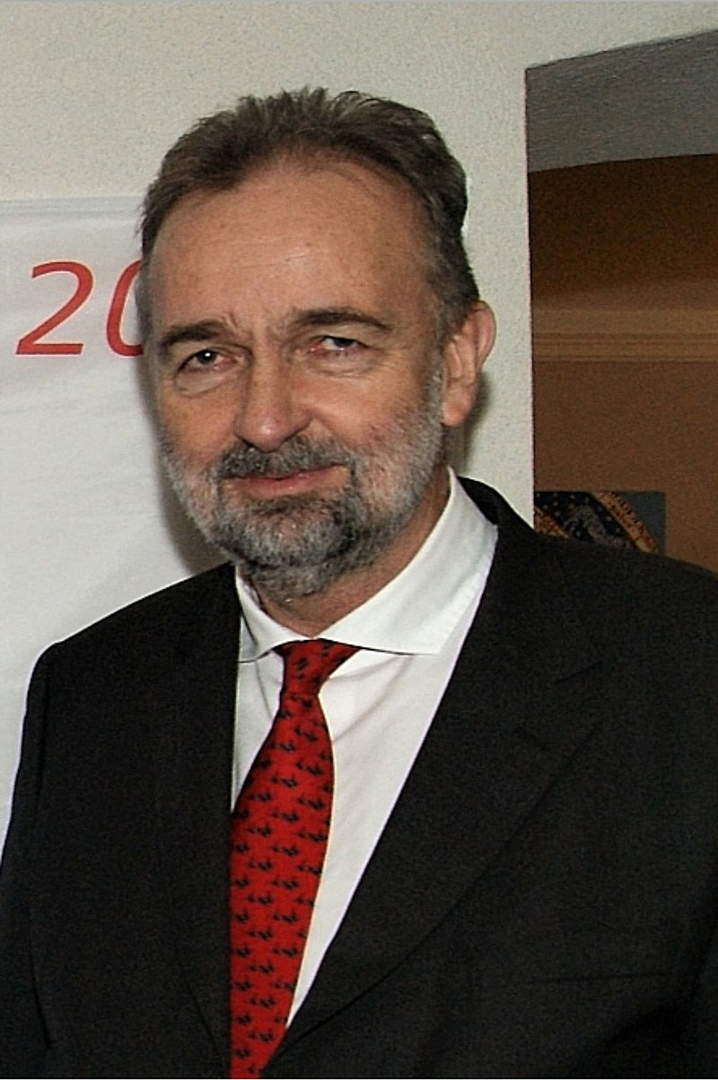
The European Situation
Three groupings of people vie for the control of Europe:
The 10 Royal Families
The 13 Illuminati Families
The Bilderberg Group (the World Economic Forum)
The Illuminati Families exert a lot of influence over the Bilderberg Group
The Bilderberg Group serves as a “Board of Directors” for the World Economic Forum.
The first speaker at the World Economic Forum in 1971 was Otto von Hapsburg (Pictured to the left)!
Otto von Hapsburg was the Crown Prince of Austria-Hungary in 1917 and all his life, he was the primary claimant to the Austrian Throne. He died in 2011, his son Karl von Hapsburg is the “heir apparent.”

Slide 9
The Thirteen Illuminati Families
The Astor Bloodline
The Bundy Bloodline
The Collins Bloodline
The DuPont Bloodline
The Freeman Bloodline
The Kennedy Bloodline
The Li Bloodline
The Onassis Bloodline
The Rockefeller Bloodline
The Russell Bloodline
The van Duyn Bloodline
The Merovingian Bloodline
The Rothchild Bloodline

Slide 10
The Ten Royal Families of Europe
The House of Saxe-Coburg-Gotha* (Windsor) (Cadet of the Wettin Line)
House of Bourbon (France)
House of Hapsburg (Austria)
House of Bernadotte * (Sweden)
House of Orange * (The Netherlands, England)
The House of Wettin (Belgium, Poland, et. al.)
The German Royal lines

Slide 11
The Ten Royal Families of Europe
The German Royal Houses – Four Houses – Only One Will Survive?
House of Hohenzollern (Bavaria-Prussia) The Last German Kaisers (kings) were from this house. (Wilhelm I, Wilhelm II)
House of Cronenberg (Germany-Austria)
Two of the Princes and the king in the TV Show Grimm were Cronenbergs though they spelled it Kronenberg. There was one that was either a Windsor or a Hanover prince. (British Accent)
House of Wittelsbach (Northern Germany)
House of Oldenburg (Holstein, Denmark, Norway)
Other German Families of Note:
The House of Hanover (once ruled Great Britain, now extinct)
House of Nassau (now extinct)
House of Wettin (now the House of Saxe-Coberg-Gotha in Great Britain)

Slide 12
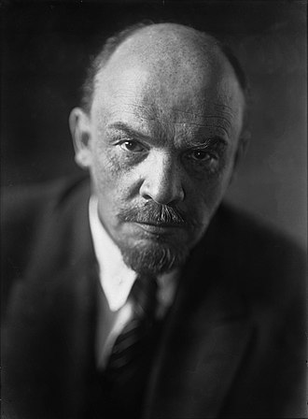
The “Monkey Wrench” in the Works
The House of Romanov is one of the oldest ruling families in the world. Their dynasty started in 1613 and ended in 1917.
The “bone of contention” is that Great Britain and the United States employed Vladimir Lenin to start a revolution in Russia to depose the Tsar.
Unfortunately for the Allies, Lenin was compromised by German spies on his train trip to Russia.
He ended up getting Russia out of World War I.

Slide 13
The Banking Cartel’s Failures
For the Banking Cartel, the 18th and 19th centuries were a disaster for them:
In Great Britain, they lost their colonies in North America.
In Spain, they lost their Latin American colonies.
In France, they lost their North American Colonies and their holdings in the West Indies (Haiti).
In the Napoleonic Wars, Napoleon proved to have a mind of his own and started to disobey their orders. Napoleon looted French banks to finance his wars.
The Revolutionary attempts of 1848 destabilized the major governments of Europe and weakened all the monarchies of Central Europe.

Slide 14
The Banking Cartel’s Failures
Their biggest disaster was the Revolution in France that deposed the House of Bourbon. Much of the ruling class of France was guillotined by the revolutionary government of Maximillian Robespierre. He was deposed in 1798 and Napoleon I took over.
When Napoleon I lost at the Battle of Waterloo, his son, Napoleon II ruled for a short time in 1815.
France was able to restore the Bourbon Family to the French throne in 1815 and they stayed there until 1848 when a revolution put the Bonaparte family back in power.

Slide 15
The Policies of the Last French Empire
Charles Louis Napoleon Bonaparte III owed his very existence in power to the Rothchild banking system.
His social programs included:
Worker’s Compensation
Free Legal Assistance for the Poor
Low-Cost Housing
Free Medical
Labor Rights
Women’s Rights
Infrastructure Improvements

Slide 16
The Last French Empire
Charles Louis Napoleon Bonaparte III was Emperor of France from 1852-1870. He was very liberal for his time, but in the end, his social reforms cost too much, and he had to engage in wars to keep his economy going:
Crimean War with Great Britain (1853-1856)
Franco-Austrian War of 1859 to protect Papal interests in Italy.
Second French Intervention in Mexico (1861-1867, the first being the Pastry War of 1838)
A Similar Situation to the Vietnam War for the USA
Afghanistan for Russia and the USA
Franco-Prussian War of 1870 to curb the power of the Prussians (who wanted to unify Germany)
When French efforts in the Franco-Prussian War did no go well, he went to the front to take over command. He was captured at the Battle of Sedan. He lost power after that. France returned to the republican form of government, never to have a king or emperor again.

Slide 17
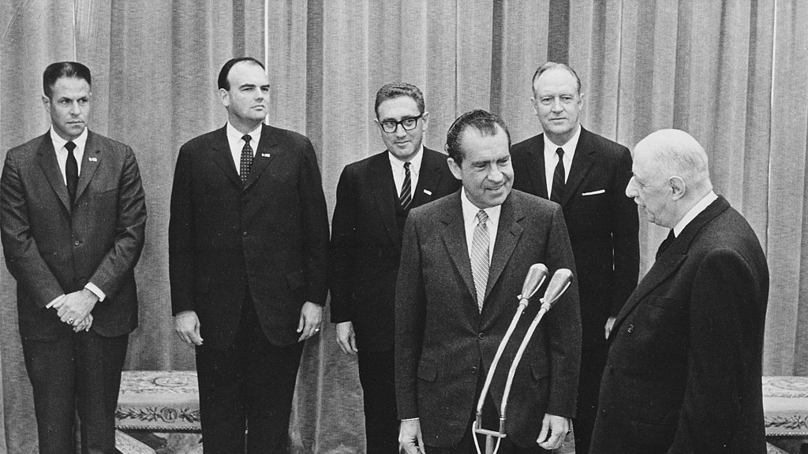
The Republican France
The debts of France created by Louis Napoleon III would never go away. Even with many conservative governments, France ended up being controlled by bankers because of that debt.
World War I again destroyed the economy of France and the Great Depression served to dig France deeper in debt.
When Hitler defeated France in 1940, France’s economy went into yet another tailspin. The Vichy Government of France during the German occupation could do little to help the French people. Germany made slave labor of the French people.
Postwar France lost most of their colonies and suffered militarily. Their loss in what is now Vietnam made the French realize that their days of colonization were over.
Whatever the media says, France is still riddled in debt and is compelled to do whatever the bankers tell them, which is now, “do what the World Economic Forum tells you.”

Slide 18
The Second Reich in the 20th Century
Many countries feared a united Germany. The power of Bavaria’s pharmaceutical and chemical companies, coupled with the Ruhr River valley’s war plants, and Prussia’s automobile industry, along with other components of the 39 republics made a potential Germany an economic powerhouse that would tap the energies of Europe.
As long as Bismarck was alive to keep Germany together and out of war, Germany would be successful. Bismarck also had to resist the temptations of socialism.

Slide 19
The Second Reich in the 20th Century
Many countries feared a united Germany. The power of Bavaria’s pharmaceutical and chemical companies, coupled with the Ruhr River valley’s war plants, and Prussia’s automobile industry, along with other components made a potential Germany an economic powerhouse.
As long as Bismarck is alive to keep it together and keep it out of war, Germany will be successful. Bismarck will also need to resist the temptations of socialism.

Slide 20
The Second Reich in the 20th Century
Otto von Bismarck resigned from his office in 1895 when he could not get along with Kaiser Wilhelm II. He was one the few German politicians to understand the implications of what would happen if Germany got into a World War.
Kaiser Wilhelm II wanted to secure Germany’s “place in the sun,” similar to Hitler’s “living space”(Lebensraum) and was willing to go to war to get his desires. World War I would further destroy the Royal Families’ hold on Europe.

Slide 21
The Results of World War I
When 1917 Russian Revolution took place, the Romanov Family was deposed from their throne. Russia would have a communist government until 1991.
In 1918, Kaiser Wilhelm II was obliged to abdicate his throne and flee to Belgium.
The House of Hapsburg was deposed in Austria in 1919.
Only Great Britain, Sweden, Norway, Italy, The Netherlands, and Belgium retained their monarchies.
Italy lost its monarchy in 1922 when the Fascists, led by Benito Mussolini deposed Italy’s Monarch: King Victor Emmanuel III.

Slide 22
The Bankers Results of World War I
Germany lost out on three fronts:
They built up a lot of debt from the War itself and,
The owed a considerable amount of War “Reparations” to France, Great Britain, and Belgium.
A German Revolution brought in the Weimar Republic in 1919 and the bankers literally controlled Germany.
Great Britain and France were also heavily in debt to the Banks and to the United States.

Slide 23
The Bankers Results of World War I
After World War I, the world economies were in major flux.
By 1920, the Royal Families had lost most of their power. Even in Great Britain, the country had morphed into a “Constitutional Monarchy.” The King had very little power except to dissolve Parliament at the request of the Prime Minister and call elections.
The other monarchies were also so limited. They are today!
The world underwent a Economic Depression. Money was tight and companies decreased prices to gain revenues. The U.S. Government under President Warren Harding determined that government intervention would do more harm than good. Economists like James Grant (The Interest Rate Observer) argue that Republican President Harding did the right thing. His successor, President Calvin Coolidge followed much the same policies.

Slide 24
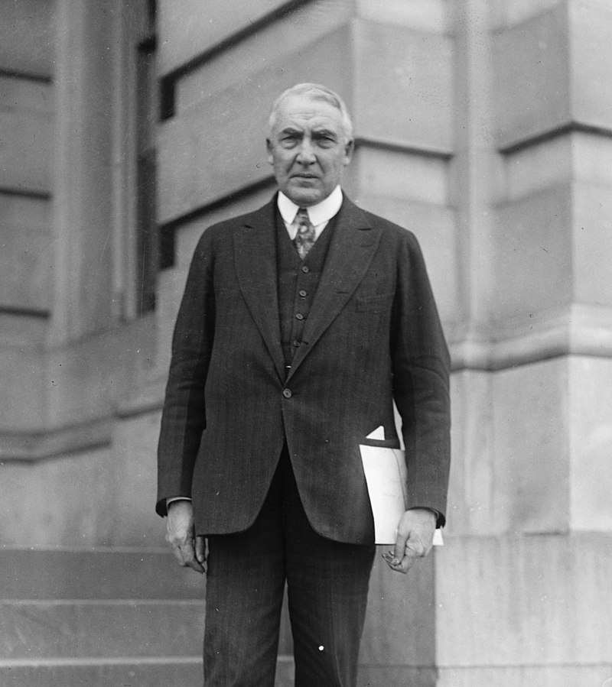
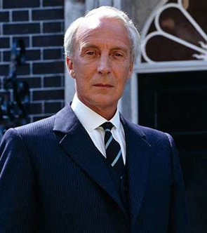
President Warren Harding
“The government that governs best governs least.”

Slide 25
The Bankers’ Results of World War I
After World War I, the world economies were in major flux.
In Great Britain, the Conservative Party dominated Parliament, except for the times when Ramsey MacDonald (Labor) was in. Therefore, the British Government followed a conservative path, as they were losing much of the economic power they once had.
In Germany, the Weimar Republic strived to stay in power. Both the Communist and Right-Wing parties vied for power and fomented revolutionary coups. The most notable was Hitler’s “Beer Hall Putsch” in 1923. None of them ever went very far.

Slide 26
The Bankers’ Results of World War I
After World War I, the world economies were in major flux.
The Royals families went into a “retreat” of sorts. They may have realized that they only way they can get their power back is to work together to establish a regime.
They had worked to get a “foothold” in Germany by getting Hitler to restore the Kaiser in a limited monarchy government. Hitler refused, realizing that in the end, he could not trust them.
His realization proved true when Otto von Hapsburg attempted to fight Germany’s annexation of Austria.

Slide 27
The Royal Families Plot to Subject the World

Slide 28
The Royal Families Plot to Subject the World

Slide 29
The Bankers’ Results of World War II
World War II was the first time a U.S. Bank was caught financing an enemy. The Union Banking Corporation founded by Prescott Bush. However, the bank was owned by Bank voor Handel en Scheepvaart, N.V., a bank from The Netherlands.
This bank had significant connections to the United Steel Works in Nazi Germany. United Steel Works was owned by the Thyssen Brothers.
In the 1990s, United Steel Works merged with Krupp Steel to form the largest steel company in the world. The new company is called ThyssenKrupp AG. They are a huge conglomerate. The truck pictured in the background was photographed in Trinidad, Colorado in 2022.

Slide 30
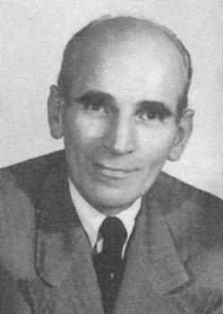
The Bankers’ Results of World War II
Without this convention, Escher Wyss, A.G. would have never survived the War. This company was managed and controlled by Klaus Schwab and his father. They developed turbines that created “heavy water” for the Nazis nuclear program. The company survived until 1969 when it was bought by Sulzer, A.G.

Slide 31
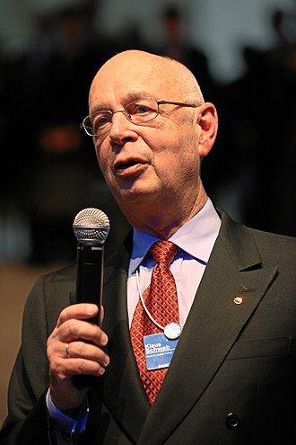
The Bankers’ Results of World War II
Without this convention, Escher Wyss, A.G. would have never survived the War.
This company was managed and controlled by Klaus Schwab and his father.
They developed turbines that created “heavy water” for the Nazis nuclear program.
The company survived until 1969 when Dr. Schwab sold it to Sulzer, A.G. , a now very large conglomerate with locations all over the world.

Slide 32
The Bankers’ Results After World War II
While most European countries were saddled with debts from the War, the United States was convinced, due to the Communist threat, to rebuild Europe via the Marshall Plan.
This gave the United States a reason to occupy West Germany until 1991 when the Berlin Wall was taken down.
Afterward, when Germany was reunited, the U.S. and Germany wrote a new agreement allowing the Luftwaffe (German Air Force) to have bases in the United States while the United States maintains Army and Air Force Bases in Germany.

Slide 33
The Royal Families After World War II
After the War, the sun finally set over the British Empire after three centuries.
Singapore was given its independence.
Their Middle Eastern holdings were given their independence.
India was given its independence… only to break up into India and Pakistan. They have been in a state of Cold War since.
Many of their African holdings also obtained their freedom.
Great Britain did continue to produce and refine petroleum in their former colonies.

Slide 34
The Royal Families After World War II
After the War, the British Empire suffered economically as they tried to rebuild from the War.
Even though the Royal Families lost much influence, they still have their business holdings in trusts holding substantial shares in Royal Dutch Shell and British Petroleum. They have other investments as well.
The British economy tends to follow the United States economy.
The British Pound continues to be the medium of exchange.

Slide 35
Banking in the United States
The biggest obstacle for the Rockefeller Family in controlling the banking system of the USA was the lack of Interstate Banking.
e.g., A Bank in New York could not own a bank in New Jersey.
While the Federal Reserve controlled Nationally-Chartered Banks, the individual state-chartered banks were controlled by the state chartering the bank. The state banks could opt to buy shares in the Federal Reserve, but none of them ever did. Most banks did not want anything to do with the Federal Reserve.

Slide 36
Banking in the United States
The biggest obstacle for the Rockefeller Family in controlling the banking system of the USA was the lack of Interstate Banking.
If a state-chartered bank needed funding for a particular loan, they would draw up a “loan package” and take it to a “Correspondent Bank.”
The Correspondent Bank would review the loan and either finance it themselves (happened about 50% of the time) or farm the offer out to other larger banks in the region.
Banking was decentralized, as the management of the local bank made the decisions.

Slide 37
Banking in the United States
Here is a chart of how the banking situation works:
Local Bank (State Bank in Iowa)
Correspondent Bank (Merchants National Bank. Cedar Rapids, Iowa)
Major Investing Banks Major Investing Banks Major Investing Banks
Norwest Bank Bankers’ Trust Company First National Bank-Omaha
Des Moines, Iowa Des Moines, Iowa Omaha, Nebraska

Slide 38
Banking in the United States
Correspondent Banks offer services to smaller banks:
Transfer of funds to foreign countries.
Wire Transfers
Additional Financial Analysis on Loans
Brokerage Services through an affiliated Investment Bank

Slide 39
Interest Rate Analysis
The Federal Reserve Open Market Committee uses interest rates to manage the national economy.
When the economy is doing well, interest rates are raised to control monetary inflation.
When the economy is in recession, interest rates are lowered to stimulate the national economy.
*Federal Reserve Chairman Paul Volker testifying before Congress in 1981, Courtesy of the New York Times

Slide 40
Interest Rates
Here is a chart outlining the history of interest rates since 1950.

Slide 41
Interest Rates
Here is a chart outlining the history of interest rates since 2018.

Slide 42
Trump Financial Policies
When Donald Trump was elected president, he mandated that interest rates should be raised at slight intervals to control inflation and to reduce financial risks in the marketplace.
A reasonable interest rate discourages risky investments. It also insures that people will get a reasonable return on their savings.
When inflation was deemed to be controlled in 2018, interest rates were lowered.

Slide 43
The 2020 Panic
When it was deemed there was a “Pandemic” in the offing, the Federal Reserve lowered interest rates to zero.
Suddenly, the Venture Capital Companies started investing in business startups that they would not normally consider.
Even Silicon Valley Bank [NASDAQ: SIVB - Trading Halted March 9, 2023] started loaning money to “woke” startups.

Slide 44
The Silicon Valley Bank Debacle
Red Circle Indicates Bank “Run”

Slide 45
Silicon Valley Bank Analysis
During the 2019-2021 Period, the bank received SIX BILLION DOLLARS in new deposits that they needed to invest to offset their “Cost of Capital” requirements.
Remember, all business accounts are paid interest equivalent to the Bank Prime Rate set by the Federal Reserve!
The bank’s management opted to invest in 10-year Treasury Bonds at an interest rate of 1.68%.
Many investment managers would consider this investment sound, were it not for the trend of rising interest rates.

Slide 46
Silicon Valley Bank Analysis
Unfortunately, we have seen that interest rates have risen from the 1-2% they were when they made most of these investments to 4.5% now.
Bank management was not initially concerned because they planned to hold the bonds until they matured in ten years.
However, on their financial statements, due to the “mark to Market” method of accounting (FAS #157), they must show an “unrealized loss” on those treasury bonds and other low interest investments.
One must wonder if the Bank’s management was aware of this accounting rule.
We do know that the Bank did not have a risk manager for several months.
Normally, publicly-traded banks carry insurance to “hedge” against these kinds of risks to their portfolio.

Slide 47
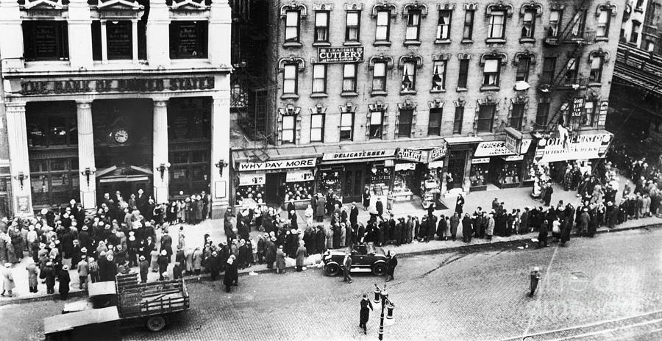
Silicon Valley Bank Analysis
When Moody’s Financial Service discovered these unrealized losses on the bank’s financial statements, they started downgrading the bank’s credit rating.
When financial analysts saw the downgrade of the bank’s credit rating, they advised their clients to move their deposits to a “safer” bank.
This caused a “bank run” but not in the sense we used to see them. This bank run was done with “mouse clicks” on personal computers.

Slide 48
Mark to Market Accounting
Mark to Market Accounting was adopted by the Financial Accounting Standards Board (per Financial Accounting Standard #157) in 1993.
It requires that companies owning “Marketable Securities” update the value of them at the end of their fiscal accounting period.
Let’s look at an example:

Slide 49
Mark to Market Accounting
A company buys 100 shares of XYZ stock for $20 a shares. The entry would be shown as follows:
Investment in XYZ Stock 2,000
Cash 2,000
At the end of the year, the stock is selling for $25.00 a share:
Investment in XYZ Stock 500
Unrealized Gain on XYZ Stock 500

Slide 50
Mark to Market Accounting
However, at the end of the next year, XYZ Stock has gone down to $15.00 a share. The entry would be:
Unrealized Loss on XYZ Stock 1,000
Investment in XYZ Stock 1,000
The final value of the XYZ Stock on the Balance Sheet would be:
Investment in XYZ Stock $ 1,500

Slide 51
Mark to Market Accounting
Traditional accounting used the cost method for valuing assets. That value stayed the same until they day came when the asset was sold. Then, a gain or loss is realized.
Mark to Market Accounting assumes profits when there are not realized.
Mark to Market Accounting assumes all assets with a ready market value are investments.

Slide 52
Thank You
Tom Mack
Email: tom.mack@whitestonefoundation.org
Bible Code Website: https://biblecodes.co
Main Website: https://whitestonefoundation.org

